Slide 1


Human Evaluation of a Robot’s Pointing Capability
Or, How I Learned to Stop Worrying About the Robot and Love the Simulation
Bryan MacGavin and Jen Tennison

Slide 2
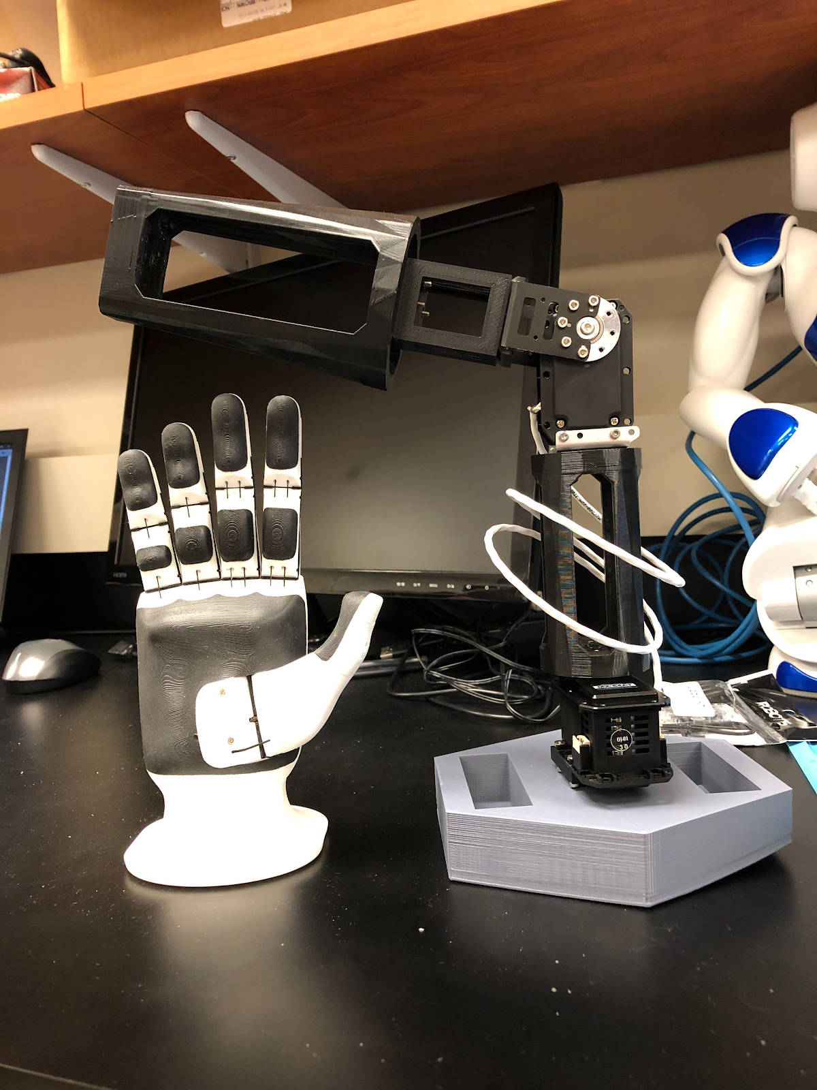
Friendship Ended with Brunel Hand 2.0
Now robot arm
is my
best friend

Slide 3
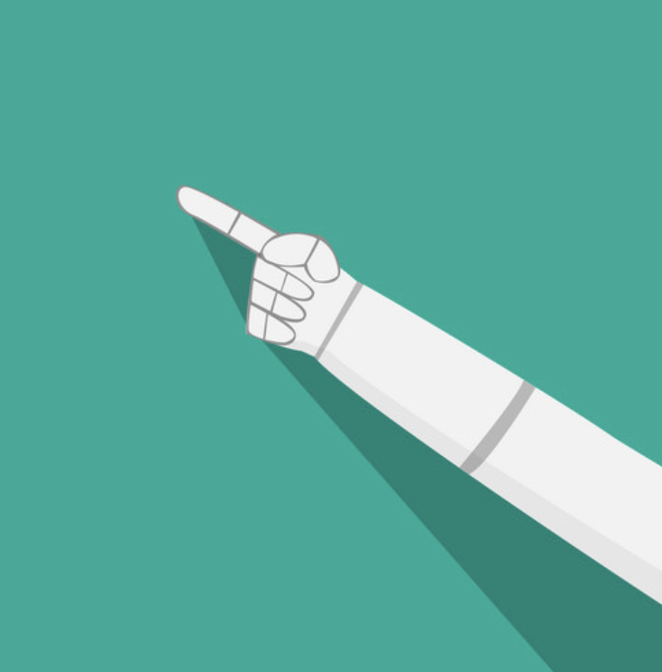
Motivating Question
How well can humans decide what a robot is pointing at, especially if the robot gestures in a “humanlike” way that is indicative of being uncertain.
How confident can we be in a robot’s pointing capability?
How precisely can we determine where a robot is pointing?
2 Experiments
Identifying a region being pointed at
Identifying a point being pointed at

Slide 4



HRI Social Building Blocks
Deixis
Kinesics
Where is the robot arm pointing?
Goal: Facilitate directional pointing to human interactors
End effector: Inflatable hand, pointer finger outstretched
Augment: Laser attached to arm underneath pointer finger to convey precise pointing locations
What path does the robot arm need to follow?
Goal: Arm must move seamlessly to each region or location. Joint trajectories must be exact every time.
Gestures: Humanlike pointing vs. robotic pointing
Implementation: ROS and python
Testing: Simulation, ROS sliders, and published messages

Slide 5
Previous Work
Robotic arms can assist and direct elderly in a home-like setting^{[1]}
Speech, speech + gesture + congruency, and speech + gesture + incongruency can affect human understanding of objects pointed at^{[2]}
The effect of robotic presence on how requests and personal space are perceived^{[3]}
Robotic visual recognition of human pointing gestures for human-robot interactions^{[4]}

Slide 6
Study Design

Slide 7
How confident can we be?
Identifying regions
Experimental Procedure
We should be able to understand the general space in which the robot is pointing
Do we need to feel confident in the robot’s ability to point in order to feel confident ourselves?
Participant stands directly behind arm.
Robot “naturally” points to 1 of 9 regions on a whiteboard.
Sometimes, arm does not go directly to the point or readjusts its position
Participants decide what region the robot is pointing.
Participants are asked how confident they are in their response.
Participant's correctness is recorded.

Slide 8


How accurate can we be?
Identifying precise points
Experimental Procedure
We should be able to understand exactly what is being point to
Participant stands directly behind arm.
Robot points to 1 of 3 targets on a whiteboard (invisible to participants).
A participant marks where they think the robot is pointing on whiteboard.
Deviation from participant’s point to robot’s point is calculated.

Slide 9
Variables to be Measured
Study 1
Study 2
Participant’s Correctness (Correct or Incorrect)
Interpreting where the robot is pointing
Participant’s Confidence (Rating Scale)
Rating their confidence in their chosen region
Godspeed Questionnaire (Rating Scale)
Rating confidence in and likeability of arm.
Deviation between points (mm)
How far away is the participant’s interpreted point from the robot’s actual point.

Slide 10
Implementation
See, what happened was…

Slide 11
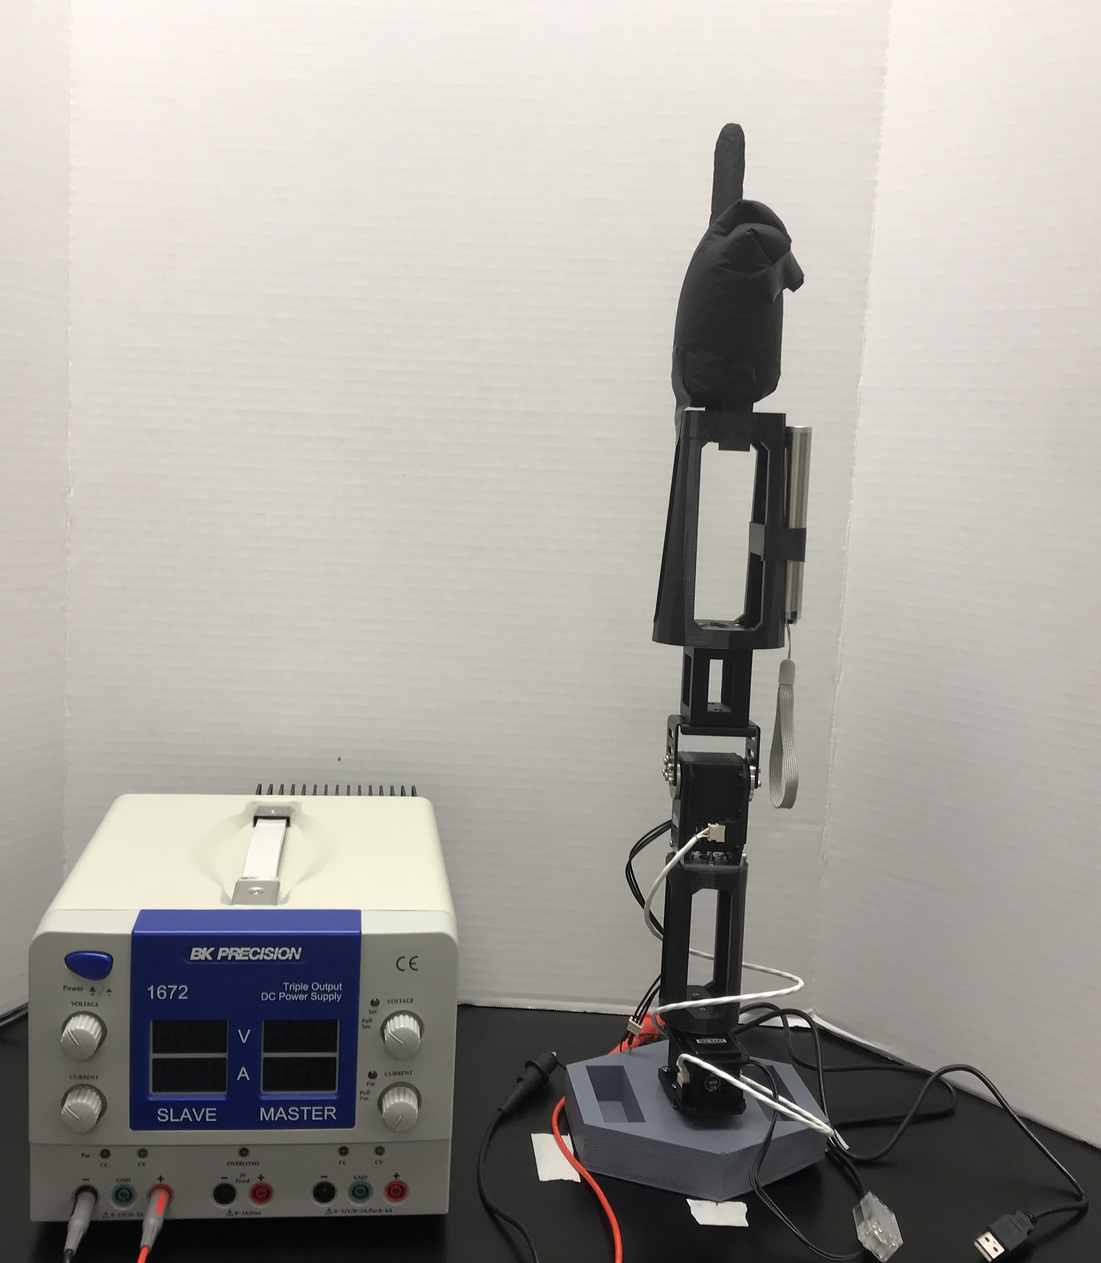
Pointing Hand
Power Supply (12 V)
Laser
Robotic Arm (2 DOF)

Slide 12
User inputs gesture
Parse text
Decide what gesture needs to be executed
Execute gesture
Wait for input

Slide 13
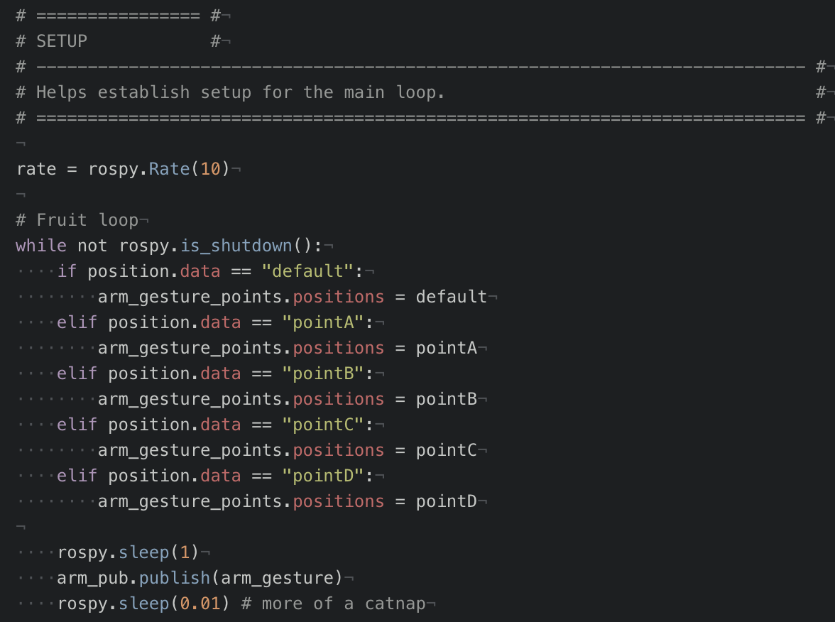

Slide 14
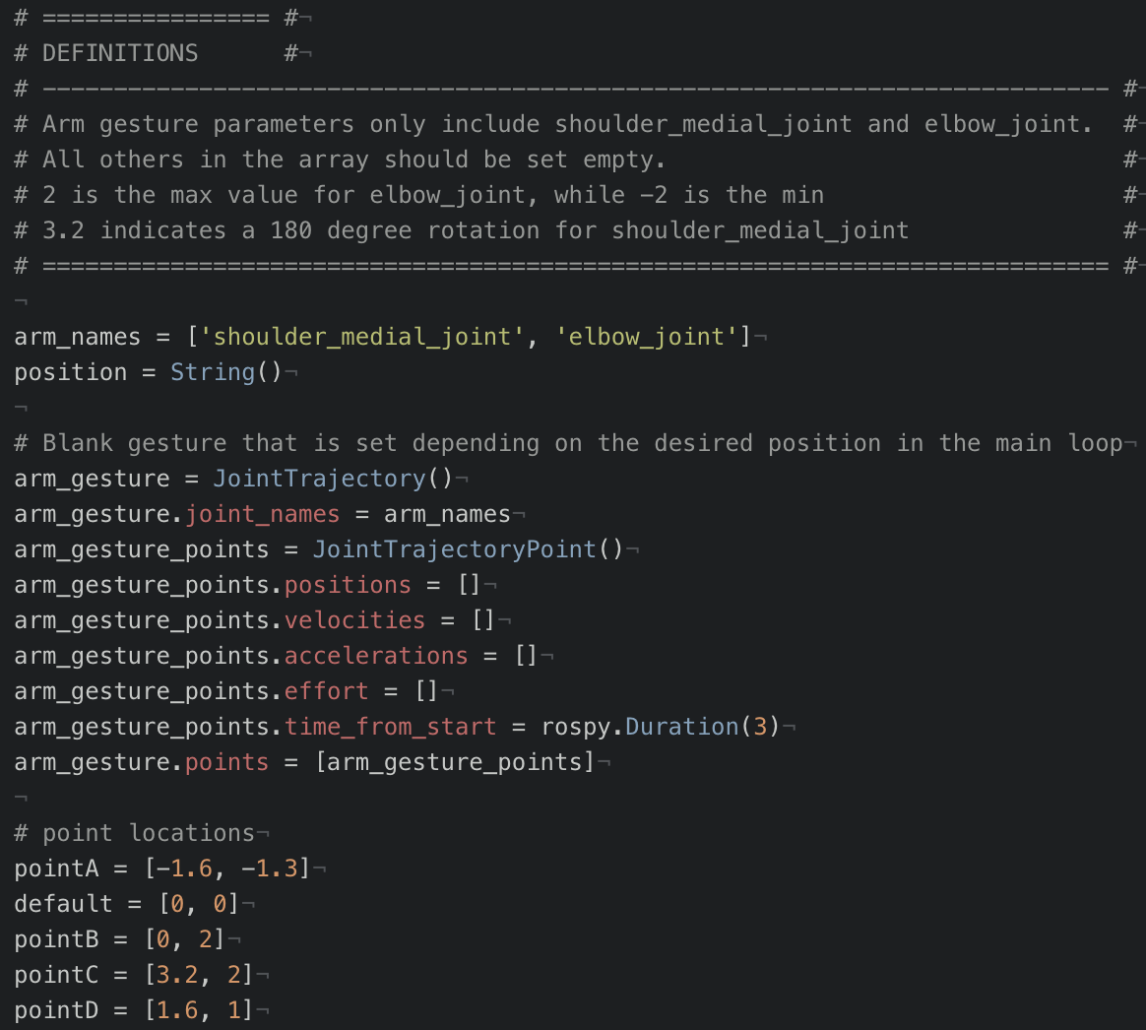

Slide 15
This worked in simulation…

Slide 16
Challenges

Slide 17
Main Challenges
Unable to reach study phase due to hardware and software challenges.
Unable to work the Brunel hand beyond demo gestures, even after updating it’s library files
A new ROS iso had to be made with up-to-date libraries, even to use simulator
A start-up routine had to be established to move arm
Error accumulation in arm trajectory movement had to be accounted for

Slide 18
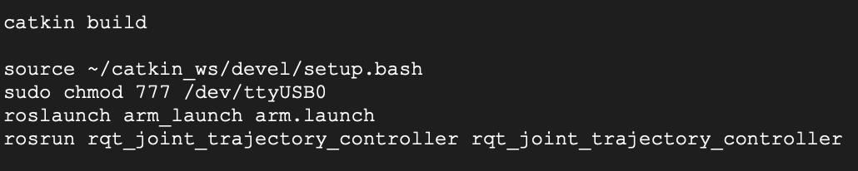
Determining the Start-up Routine
To interface with the arm and use the hardware successfully, a sequence of commands had to be run each time the USB loaded.
Builds catkin_ws packages
ROS setup
Connects to USB port
Enables hardware control

Slide 19
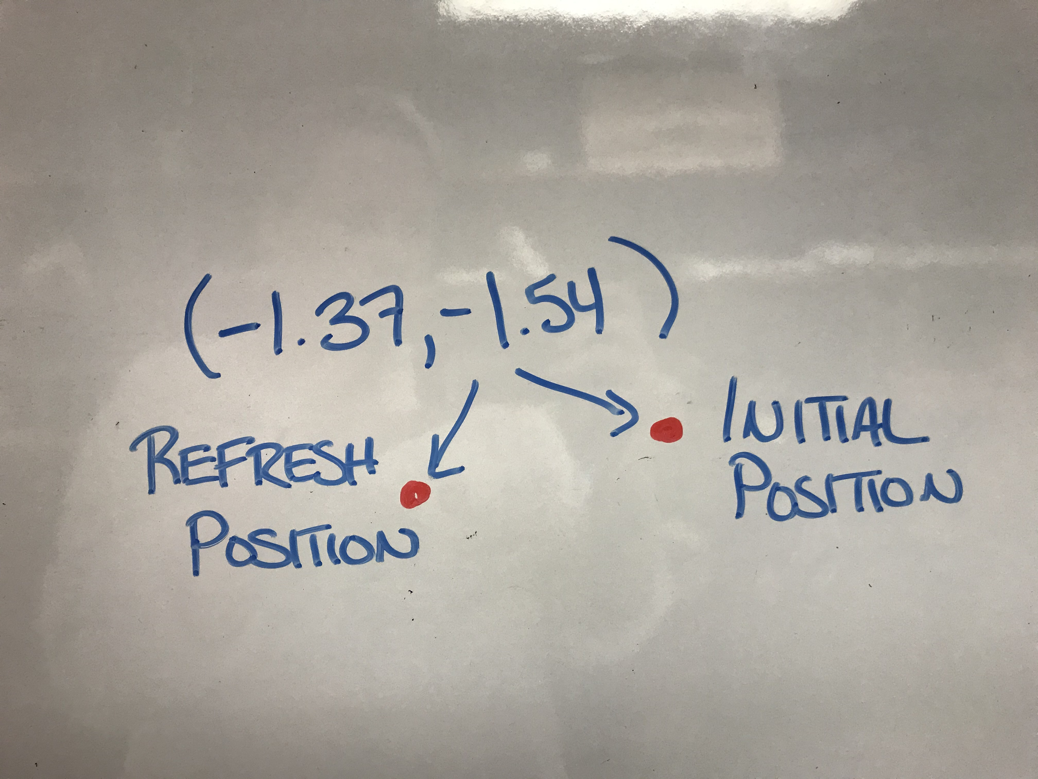
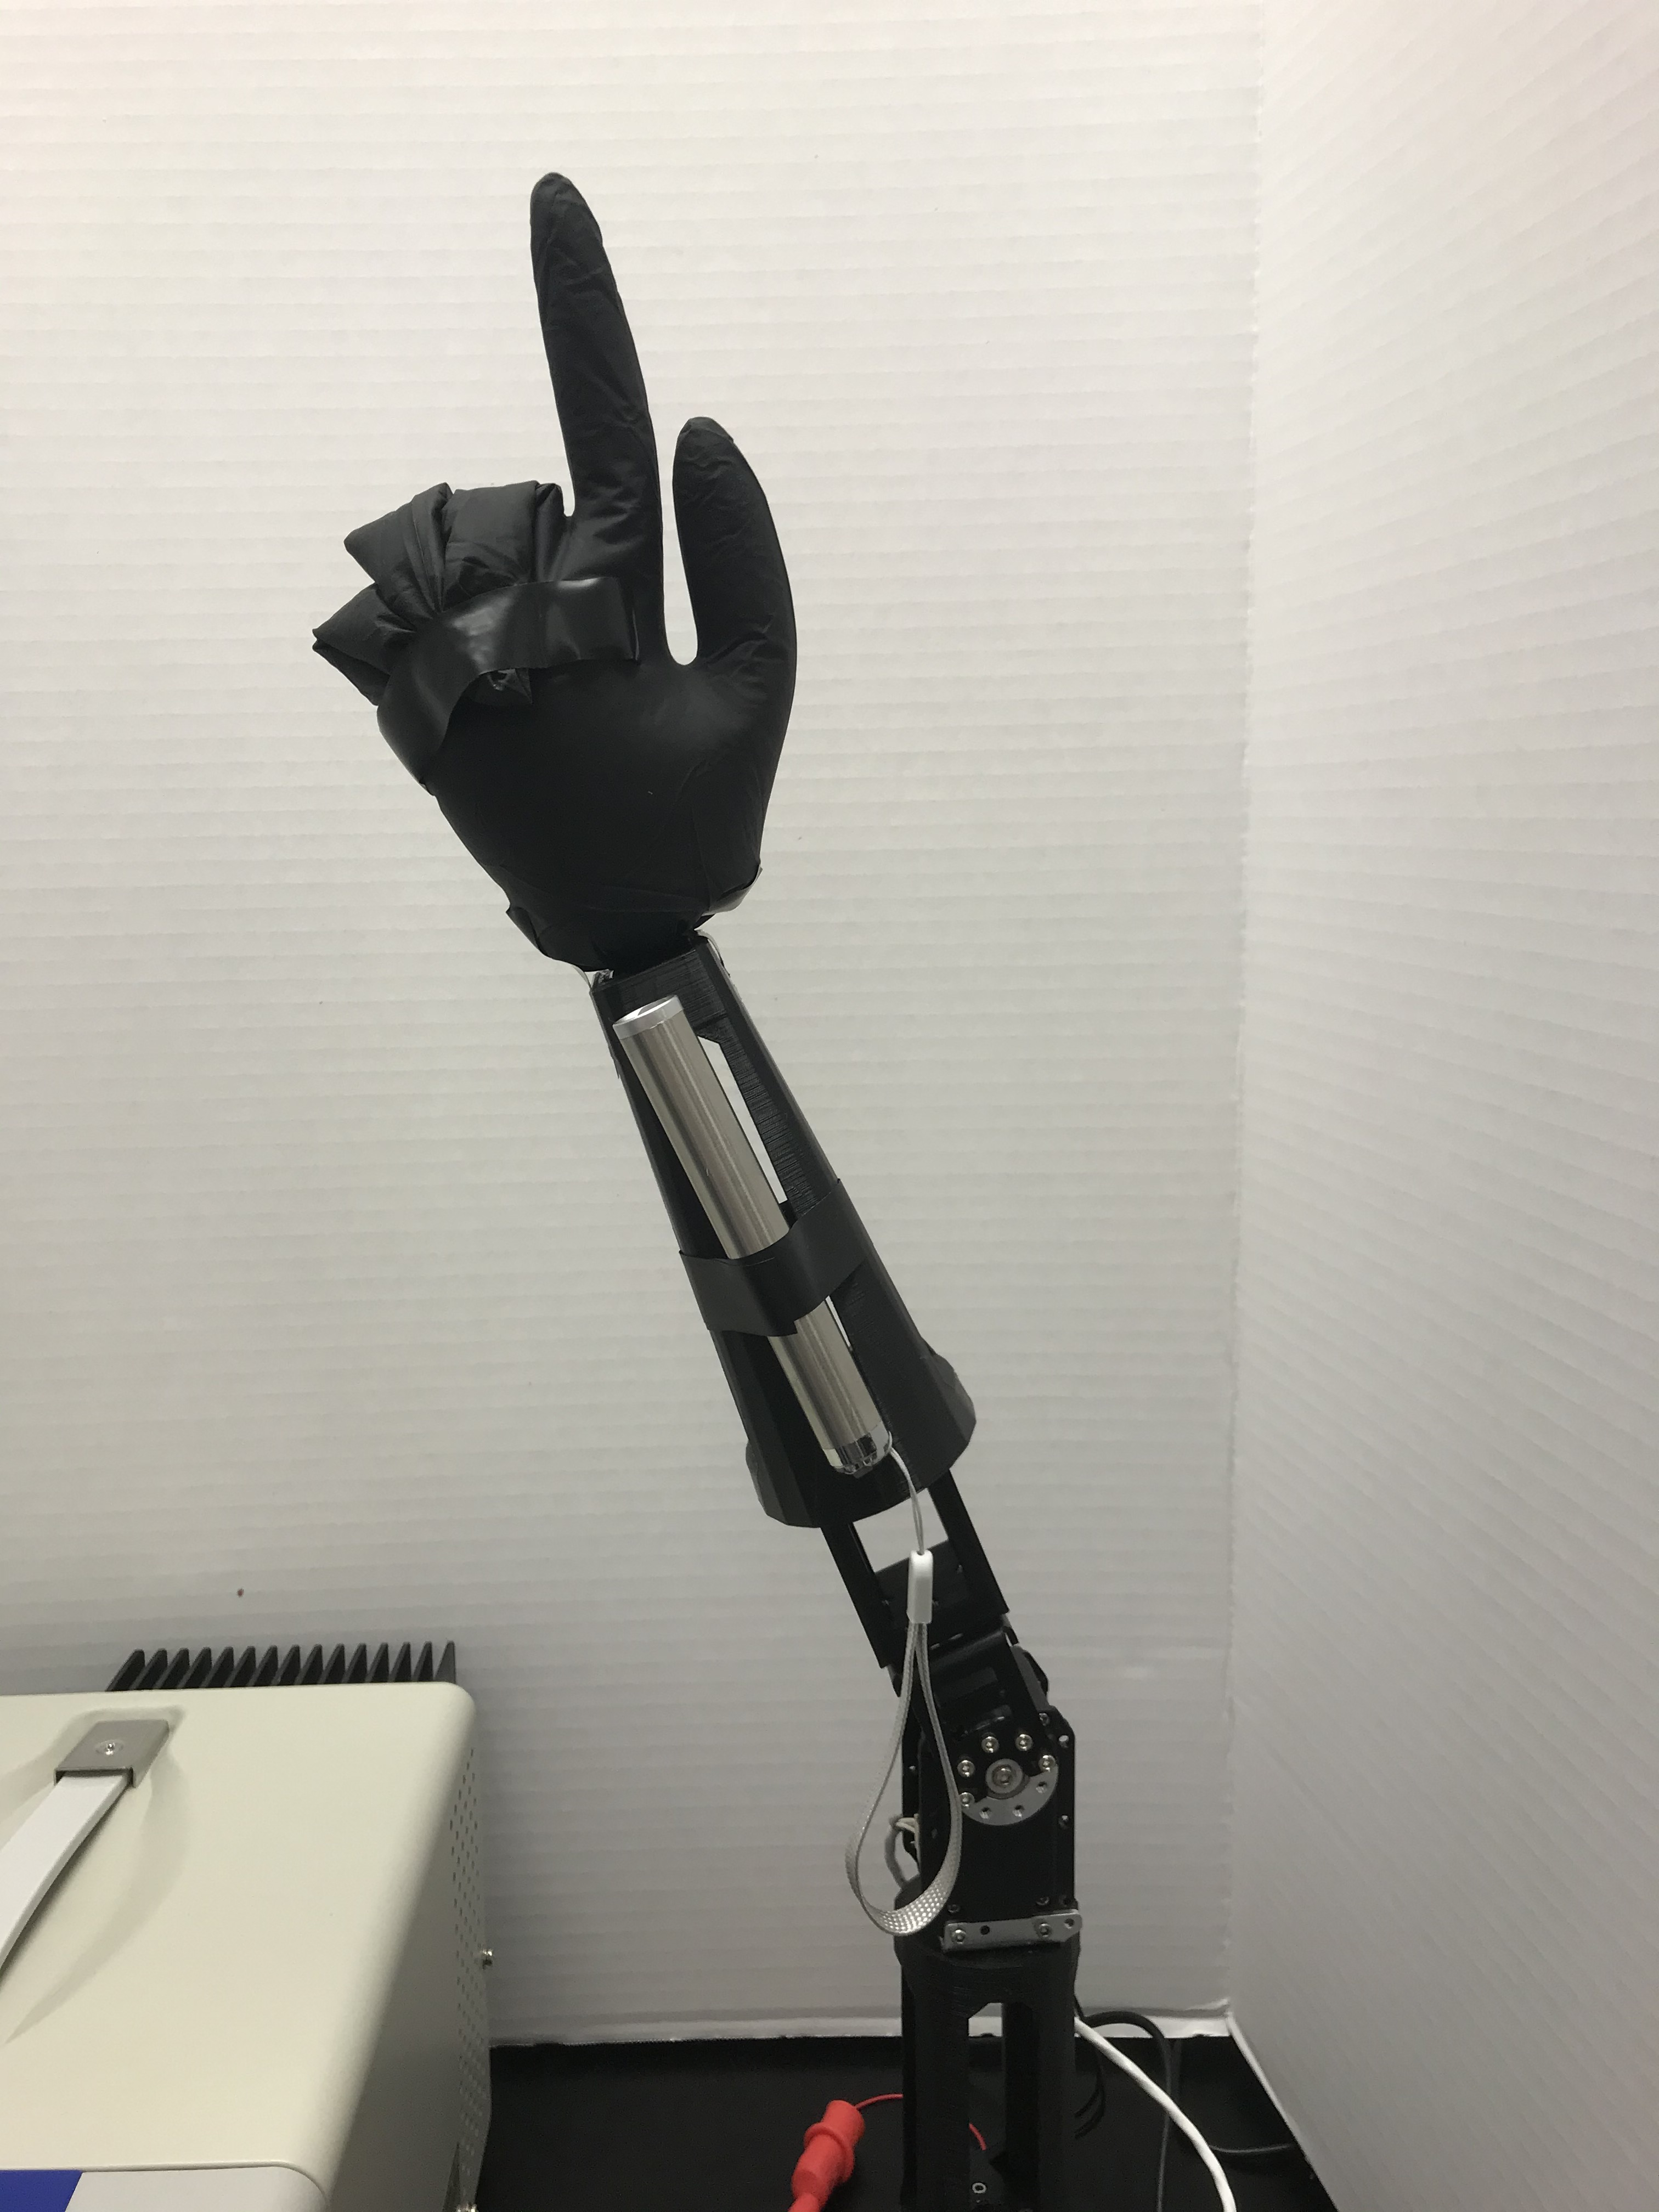
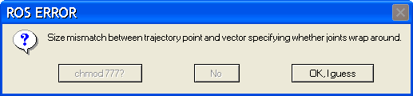
Does not fully straighten when called to default position.
Arm is also incorrectly rotated.
Repeated commands to the same point do not match in location.

Slide 20
Skills Learned
ROS and Python
How to use python to interface with the arm motors.
Structure of JointTrajectory and JointTrajectoryPoint
What can be left out and what needs to remain in the header
Debugging using a simulation, rostopic pub and echo, and the arm hardware
Git without a GUI
Using terminal-based git commands for the first time
How to use VIM even though Emacs is the superior choice
The Beauty of Improvisation and Persistence
“Just keep Swimming.” – Dory, Finding Nemo (2003)

Slide 22
References
D. Bassily, C. Georgoulas, J. Guettler, T. Linner and T. Bock, "Intuitive and Adaptive Robotic Arm Manipulation using the Leap Motion Controller," ISR/Robotik 2014; 41st International Symposium on Robotics, Munich, Germany, 2014, pp. 1-7.
Salem, M., Eyssel, F., Rohlfing, K. et al. Int J of Soc Robotics (2013) 5: 313. https://doi.org/10.1007/s12369-013-0196-9
W. A. Bainbridge, J. Hart, E. S. Kim and B. Scassellati, "The effect of presence on human-robot interaction," ROMAN 2008 - The 17th IEEE International Symposium on Robot and Human Interactive Communication, Munich, 2008, pp. 701-706. doi: 10.1109/ROMAN.2008.4600749
Kai Nickel, Rainer Stiefelhagen, “Visual recognition of pointing gestures for human–robot interaction,” Image and Vision Computing, Volume 25, Issue 12, 2007, Pages 1875-1884, ISSN 0262-8856, https://doi.org/10.1016/j.imavis.2005.12.020.

